Slide 1
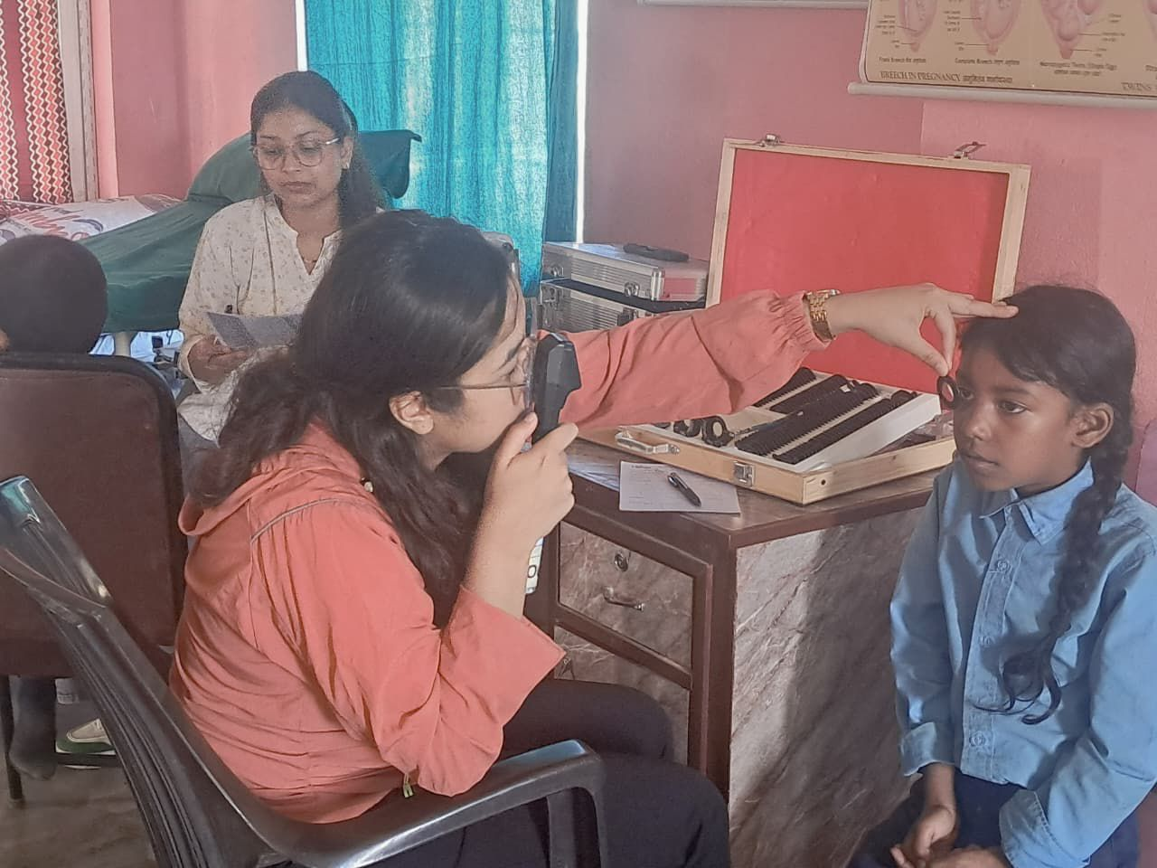
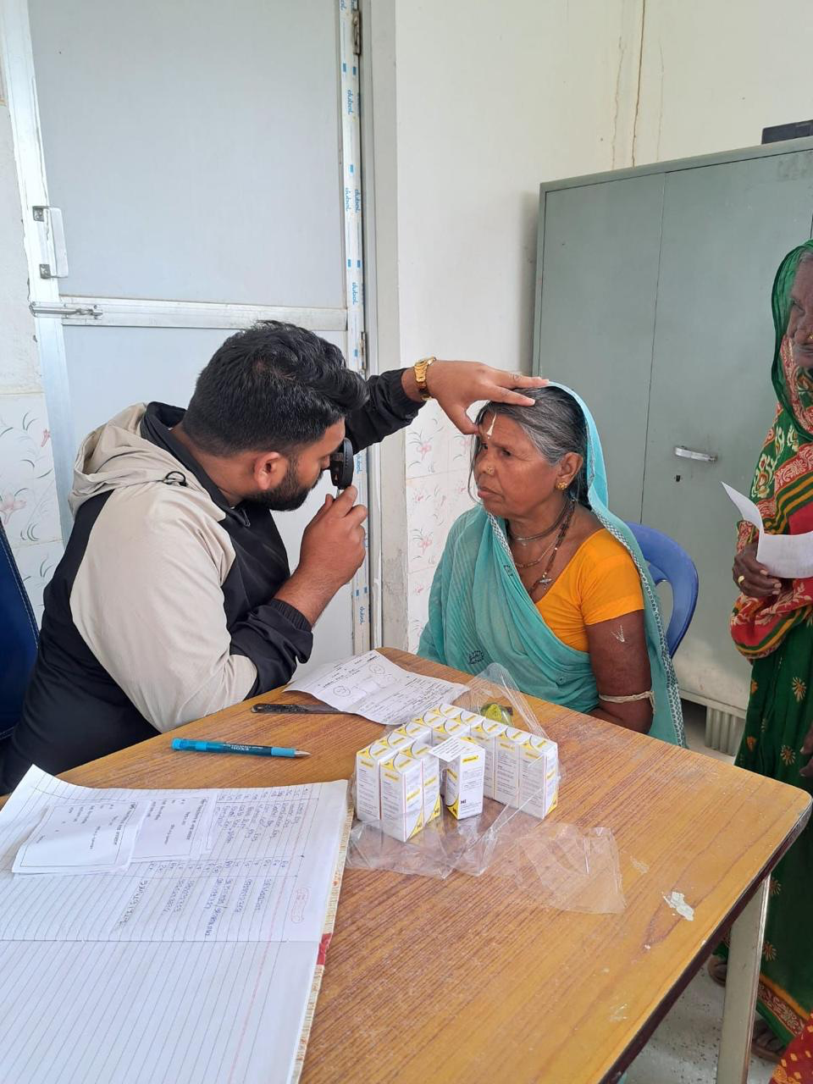
सबैका लागी दृष्टि (SIGHT FOR ALL)
Community Eye Care Support to School-Going Children and Senior Citizens of Panchkhal and Kolhavi Municipalities
Project cost: Nrs 1,767,250. UN/FIPMO Sight Group cont. Nrs 390,000
Duration: Nine months (March 2025 – December 2025)
Location: Panchkhal (Ward 1 & 2), Kolhavi (Ward 5),and Mustang
Key Interventions: Health workers and Teachers Training; School eye check-ups,Community Eye Screening cataract surgery, community awareness
Beneficiaries: 3,400 direct beneficiaries (Eye screening, glasses and cataract surgery), 11,500 indirect beneficiaries from community members
Partners: Nepal Eye Program, Tilganga Institute of Ophthalmology (TIO) - Leading eye care provider in Nepal; SIGHT Group (SG) - Formed by retired UN and multilateral staff to support community eye care.; Grande Social Foundation (GSF) - Focuses on Corporate Social Responsibility (CSR) in health and education and Local Governments - Panchkhal and Kolhavi Municipalities providing local support and resources.
Photo Courtesy Tilganga Team

Slide 2
Progress at a glance September 2025
 |  | Kolhavi |  | Panchkhal |  | Mustang |  | Remarks
S.N. | Activities | Target | progress | Target | Progress | Target | Progress
1. | Training of school teachers and school nurses. | 10 | 11 | 10 | 31 | 20 | - | Target was fully achieved in Kohlvi and Panchkhal. In Mustang, activities will take place in November as CHWs/FCHVs/school students are on break until mid October.
2. | Orientation of eye care to FCHVs. | 68 | 64 | 70 | 29 | 40 | - | The second round of orientation in Panchkhal is scheduled to take place after the Tihar festival. Mustang-same as above.
3. | Training to CHWs including AHW/ANM. | 20 | 31 | 20 | 0 | 20 | - | In Panchkhal, it will be conducted after the Dashain/Tihar festival. Mustang- same as above.
4. | School health check-ups including eye care for students. | 650 | 463 | 650 | 380 | 50 | - | In Panchkhal, out of 380 screened, 33 were diagnosed with Refractive error. This has boosed confidence among students to continue their learning. Mustang- same as above.
5. | Provision of glasses for school children with refraction error. | 60 | 30 | 60 | 33 | 20 | - | Eyeglasses to students were distributed in Kohlvi at a subsidised rate. In Panchkhal glassed were free of cost.
6. | Community-based eye screening. | 400 | 276 | 400 | 0 | 350 | - | Trained CHWs will be involved in community screenings in Panchkhal after Dashain and Tihar periods.
7. | Reading Glass distribution. | 120 | 53 | 288 | 0 | 100 | - | Subsidised reading glasses were provided in Kohlvi; whereas in Panchkhal it will be done after community screenings.
8 | Cataract Surgery. | 50 | 42 | 70 | 0 | 50 | 30 | In Panchkhal, this activity will be conducted in November.
[SB1

Slide 3
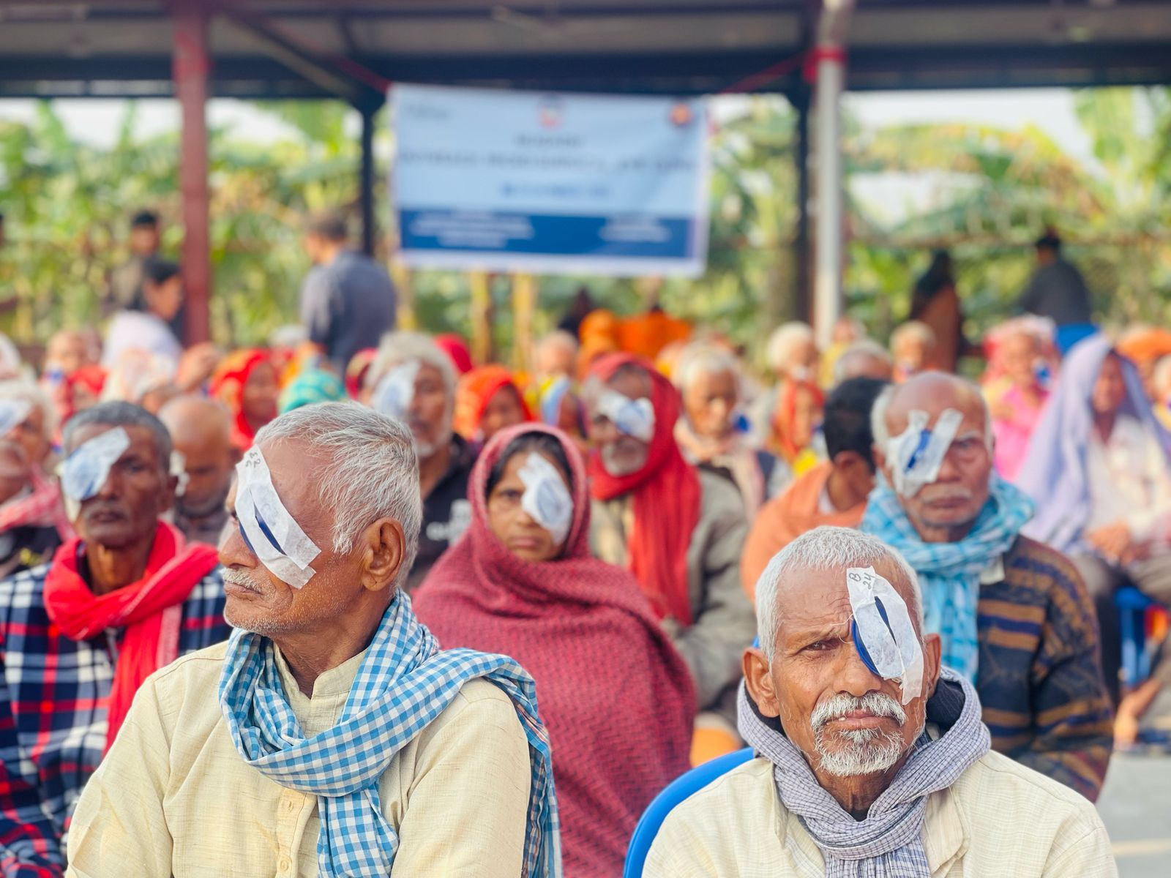
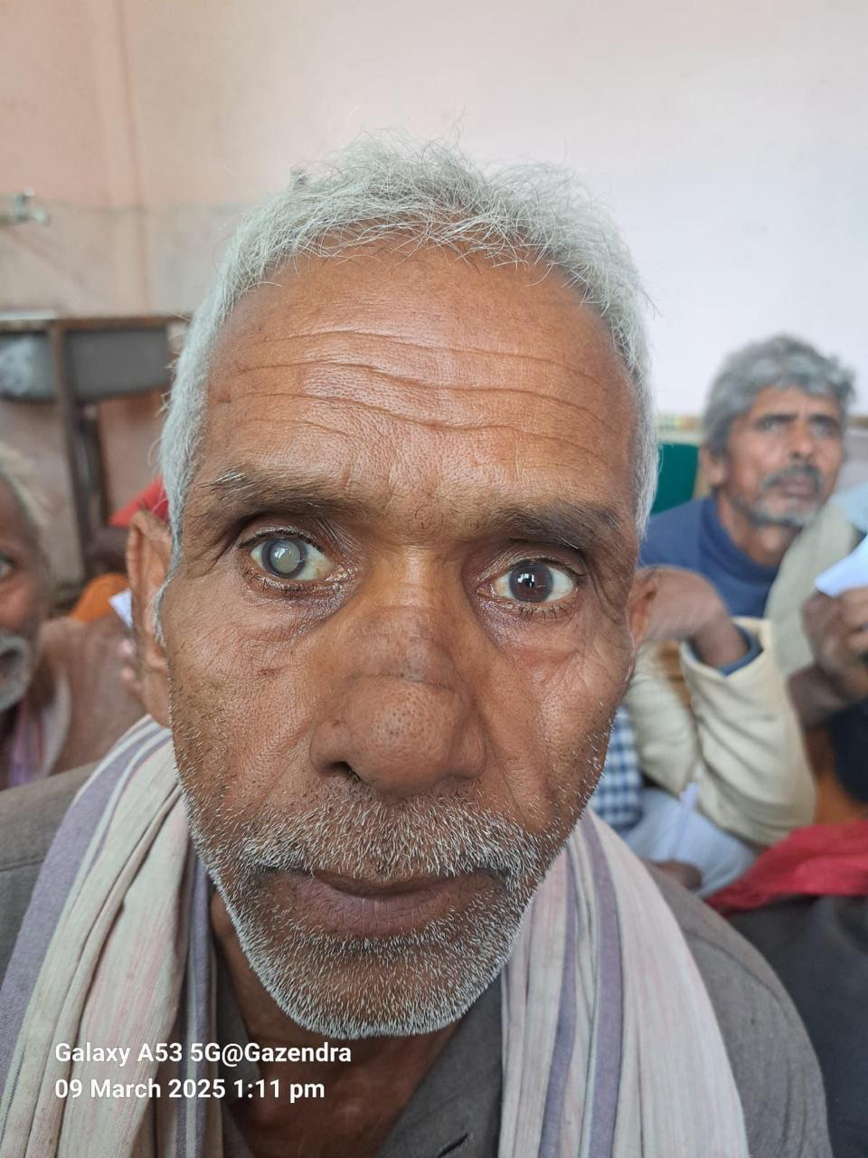
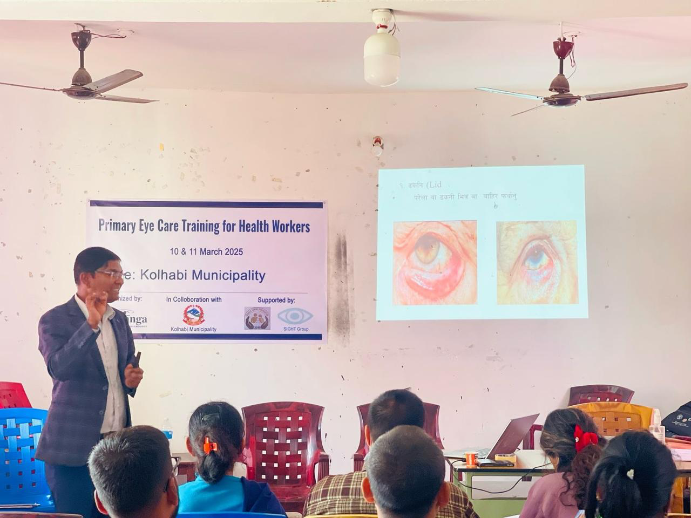
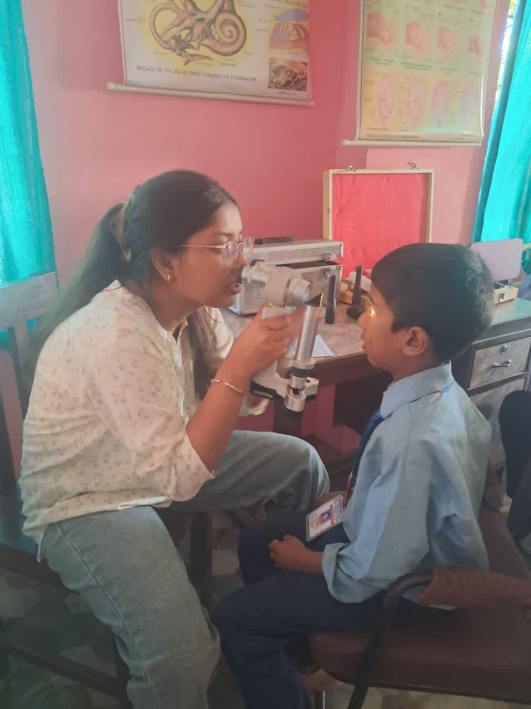
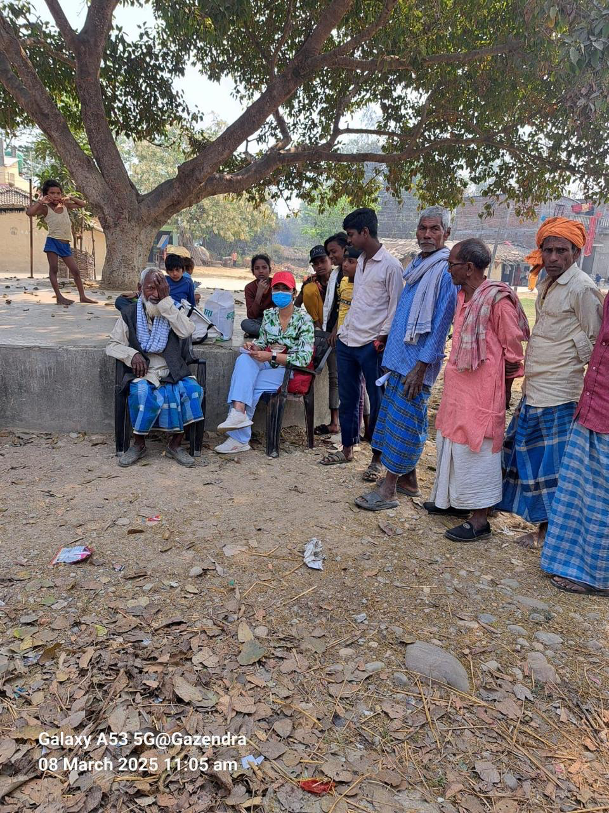
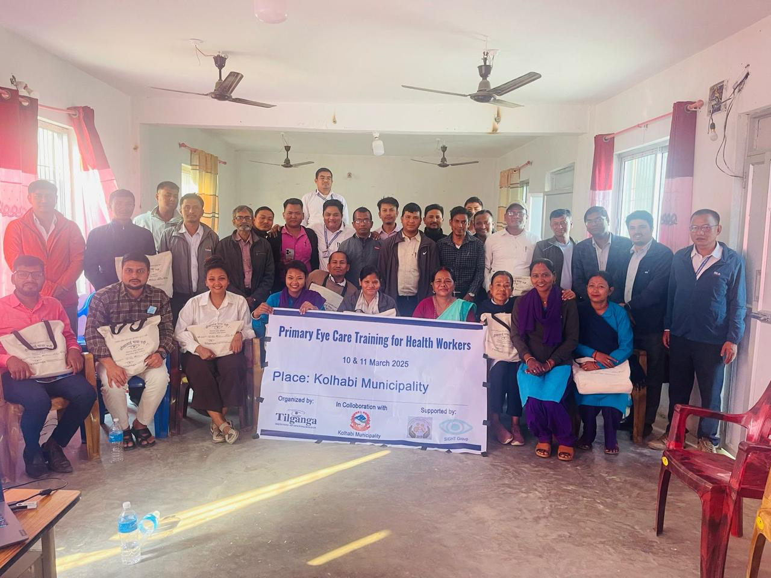
Thank you all

